Slide 1


A new system for submission and review of research proposals:
A comparison of in-house development vs. external software
Sally Gray, Wilfrid Laurier University
Andrzej Gadomski, Wilfrid Laurier University
Gordon McDonald, Process Pathways

Slide 2

The Problem
All research involving humans needs to be:
  Reviewed and approved by the Research Ethics Board (REB).
  Monitored at least annually.
  Connected to applicable funding
  Approved before funding can be released.

Slide 3
The Problem
Personnel crunch
  One individual looks after both grants and ethics.
  Duties in both parts of job have increased.
  No funds are available for additional personnel.
  Highly paid staff are doing clerical work like inputting data and producing form letters.

Slide 4
The Problem
Multi-level review process
  Psychology reviews all applications
  Other departments review only undergraduate research
  University REB reviews all graduate and PhD research, including psychology
  Reviews are across 2 campuses
  Administrators for psychology and REB duplicate each other’s work

Slide 5
Existing Process
Research Grants Officer gets email version of project, types info into Access database.
RGO chooses reviewers, e-mails copy of project to them.
Reviewers e-mail comments to RGO.
RGO compiles comments into memo for Chair to review.
RGO e-mails comments to applicant.

Slide 6
Existing Process (2)
Applicant responds with updated version of project.
RGO reviews new version and passes on to Chair for approval.
RGO produces letter for Chair to sign.
Administrative Assistant scans letter, e-mails to applicant.
Details of review kept in paper file.

Slide 7
The Solution
Software upgrades to achieve the following
  Minimize data input and errors associated with duplicate entry.
  Automate routine correspondence and reminders.
  Allow linkage of ethics application to grant funding.
  All information about review stored in same place.

Slide 8
Wish List
On-line application process (to eliminate platform problems).
On-line review (to eliminate distance issues).
Multiple review levels.
Automatic reminders and form letters.
Ability to link to grants.
Must accept attachments.

Slide 9
Solution #1
Improve existing database
Pro:
  cost effective
  RGO familiar with system
Con:
  no on-line ability
  If database shared with departments (to eliminate duplicate entry), cannot limit access to other confidential information.

Slide 10
Solution #2
In-house software development
  Pros: Can get exactly the system we need.
Cons:
  Very lengthy process.
  Need for IT and research office to understand each other.
  Requirement for dedicated project manager.
  Scope and goals need to be clearly defined.
  Future changes require extra programming time.
  Risk of the developer/programmer leaving the organization.
  Requirements for perfect code documentation.
  Multi-year project was stopped.

Slide 11
Solution #3
Vendor’s solution
Pros:
  Well defined functions and options.
  Quicker to implement.
  Price is known upfront.
Cons:
  Have to compromise on some features.
  Limited or no customization.

Slide 12
In-House
Pros:
  Security control
  Full control of data
  Access to data without need for internet
Cons:
  TCO (cost of people, technology and application)
  Strict Capacity Management
  Exposure to hardware failures (need for redundancy).

Slide 13
Cloud
Pros:
  Available anywhere.
  No necessity to purchase any hardware.
  Vendor does all heavy lifting: OS, maintenance.
  Fewer compatibility issues.
  Regular updates and maintenance.
  Flexible.
  Scalable (capacity on demand).
  Small or no upfront cost.
  Cost effective (economy of scale).

Slide 14
Cloud (2)
Cons:
  Security concerns.
  Limited control over data and environment.
  Internet connection required.
  Maintenance windows controlled by the vendor.
  Dependent on third party (Underpinning Contracts).
  Vendors might shut down due to financial hardship.

Slide 15
The Choice
ROMEO by Process pathways
  Appeared to have all features we need in the certification module (ethics review) and researcher module (on-line application).
  As a bonus, the certification module includes review for research with animals, biohazards.
  Can expand later with grants module, integrating grant application process.

Slide 16
Purchase vs SAAS
Advantages to Software as a Service (SAAS)
  Didn’t need to buy servers.
  Don’t need to pay ITS to maintain servers.
  Problems with software or service go directly to Process Pathways – the relationship between business and customer is more responsive than between two internal departments with competing issues.
  Proved more cost effective over a 6-year time period.

Slide 17
Wish List Progress
On-line application process – not implemented (need to resolve issues around individuals self-registering).
On-line review – implemented.
Multiple review levels – implemented for psychology & REB (other departments later).
Automatic reminders and form letters – in process.
Ability to link to grants – yes.
Must accept attachments – yes.

Slide 18
Next Steps
Train staff and reviewers (on-going).
Implement animal research module.
  Cleanse and migrate data
  Implement review process
  Implement on-line process for animal users – smaller group of researchers, lessons learned can be translated to ethics forms.

Slide 19





Lambton
College

Slide 20
What we hear from Research Offices
Reporting
Collaboration
Integration
Shrinking Budgets
Notes:
What is the market pain, make it HURT, not just a list of terms, these look like your speaker’s notes

Slide 21

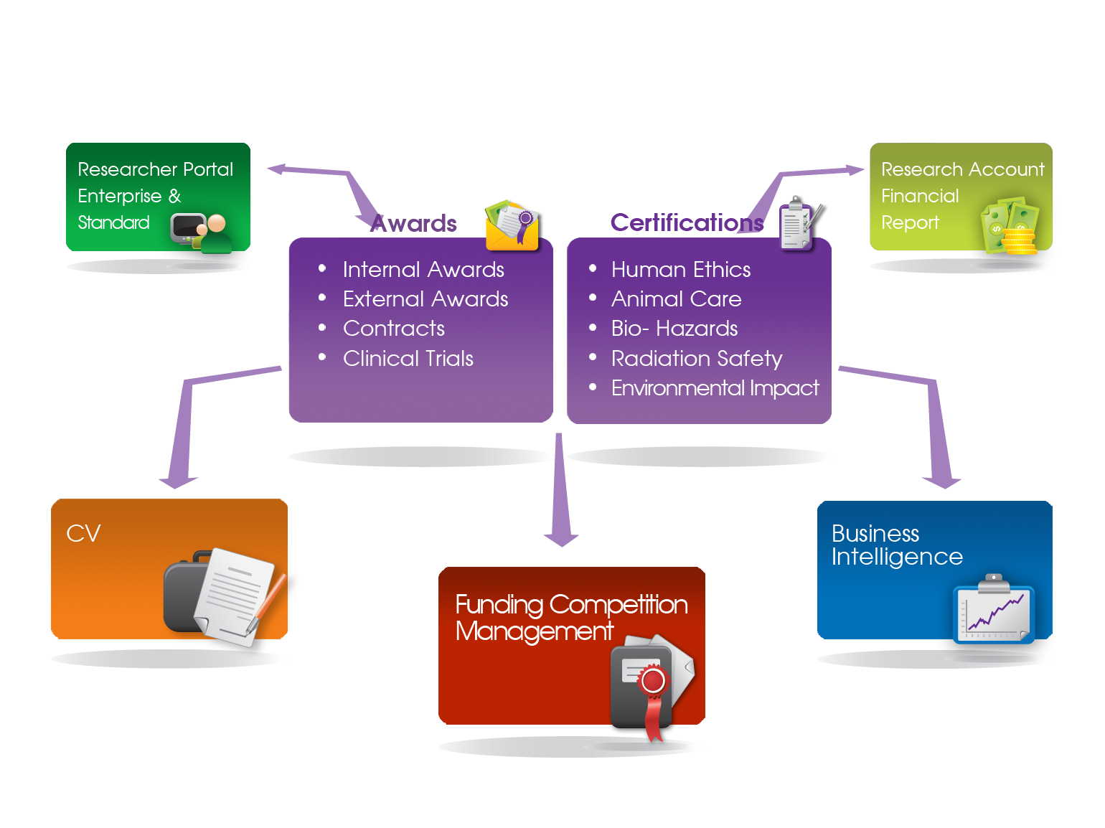
Enterprise

Slide 22







Slide 23
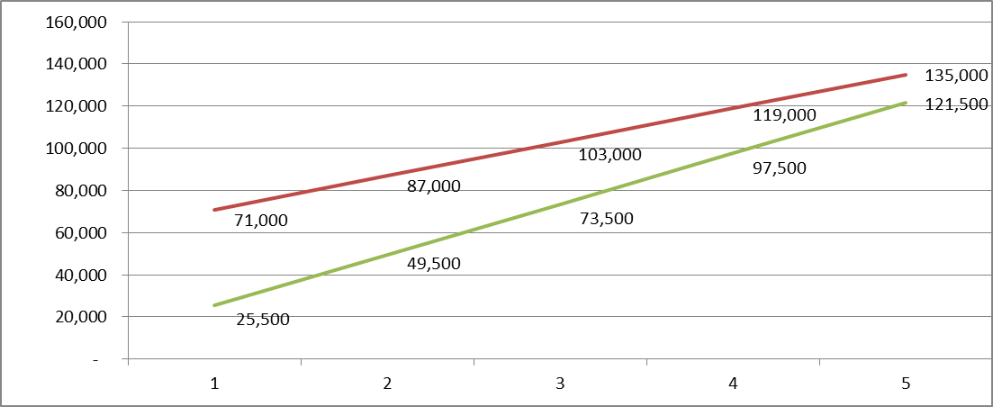
Buy
SaaS

Slide 24
Module | License | Annual | Internal Hosting & Support | Installation | 10
Purchase Perpetual License
Module 1 | 25,000 | 5,000 | 6,000 | 5,000 | 140,000
Module 2 | 25,000 | 5,000 | 3,000 | 5,000 | 110,000
 | 50,000 | 10,000 | 9,000 | 10,000 | 250,000
SaaS
Module 1 | - | 12,000 | - | 1,500 | 121,500
Module 2 | - | 12,000 | - | 1,500 | 121,500
 |  |  |  | 3,000 | 243,000

Slide 25





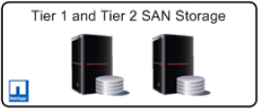
Internet Cloud
Juniper ISG Firewall (port 443)
Network Load Balancer
Scalable Application Servers
Scalable Database Server
Scalable SAN Storage

Slide 26
ROMEO SaaS Setup and Architecture for a Group
Institution
1
Institution 2
Institution
N
Firewall
Network Load Balancer
ROMEO Application Server 1
ROMEO Application Server N
ROMEO Reporting Application Server
ROMEO Database Server
Stores ROMEO Database Instance of each Institution
ROMEO Database Failover Server
Data Ware House Server
Stores Consolidated Business Intelligence Data of all Institutions
ETL

Slide 27
Security
Protected by multi-layered physical security measures
Separate physical network segments for public and private access
Firewall & VPN Services security solution to protect access control and intrusion
Data center is compliance with PIPEDA / PIPA

Slide 28
24 X 7 Monitoring
Database status monitoring
Database performance monitoring
IIS Availability monitoring and alerting
IIS Performance monitoring

Slide 29
Disaster Recovery
Predictive Failover – Triggers set at network to automatically migrate problematic hosts
Live migration between clustered nodes with no downtime
Dead node recovery in less than 5 minutes

Slide 30
Backup and Restore
Fully managed by backup and storage team
Backups delivered to high performance disk over secure network
Data encryption for maximum security
Off-site backup to Vancouver location
7 day recovery period policy to restore data

